Slide 1
Database Management System

Slide 2
Contents
DCL command
Three-schema Architecture
Component of Database Environment
Range of Database Application
DDLC

Slide 3
DCL Commands
Grant
  Syntax: Grant privileges_name On Object To user;
  Example: Grant select on CS To ‘ajay’@’localhost’;
  Grant All On CS To ‘ajay’@’localhost’;
Revoke
  Syntax: Revoke privileges_name On Object From user;
  Example: Revoke select On CS From ‘ajay’@’localhost’;
  Revoke All On CS From ‘ajay’@’localhost’;

Slide 4
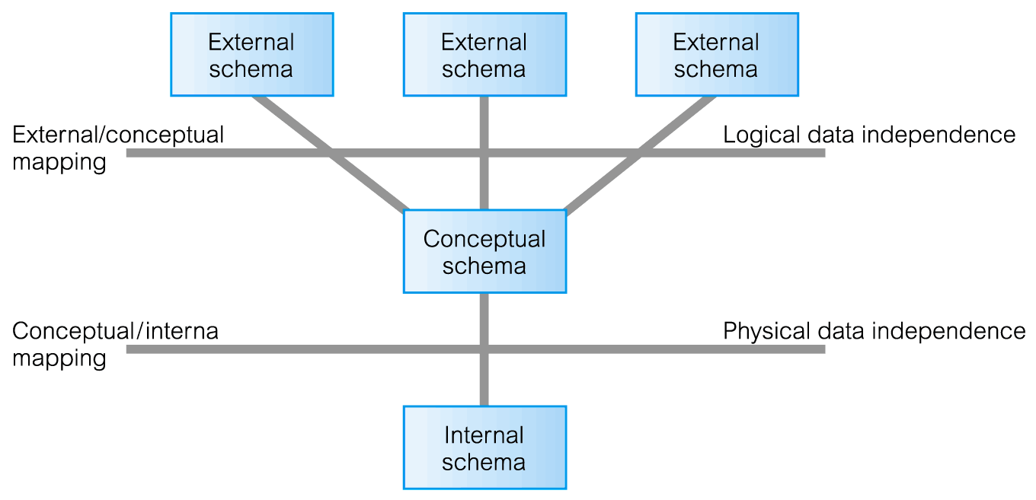
Data Independence and the ANSI-SPARC Three-Level Architecture

Slide 5
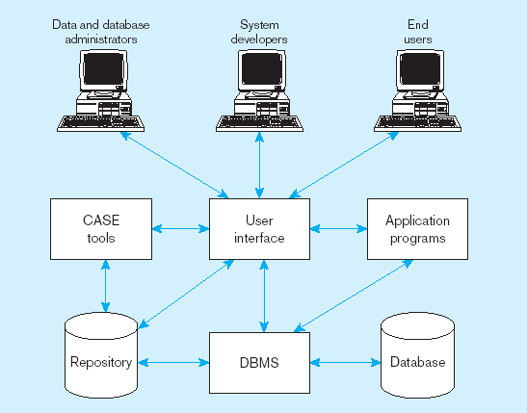
Components of the Database Environment

Slide 6
DBMS Interfaces
Menu-Based Interfaces for web Clients or Browsing. These
interfaces present the user with list of options (called menus) that lead user through the formulation of request.
Forms-Based Interfaces. A forms-based interface displays a form for each user.
Graphical User Interfaces. A GUI typically displays a schema to the user in diagrammatic form. The user then can specify a query by manipulating the diagram.

Slide 7
DBMS Interfaces
Natural Language Interfaces. These interfaces accept requests written in English or some other language and attempt to understand them.
Speech Input And Output. Limited use of speech as an input query and speech as an answer to a question or result of request is becoming commonplace.
Interface for parametric users
Interface for DBA

Slide 8
Different types of users in database
Database Administrator (DBA)
Naive / Parametric End Users
Online User
Sophisticated Users
Specialized Users
Data Base Designers
Application Programmers

Slide 9
The Range of Database Applications
Personal databases
Workgroup databases
Departmental/divisional databases
Enterprise database
Web-enabled

Slide 10
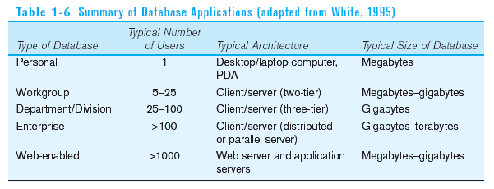

Slide 11
Database Development Life Cycle
Planning
Analysis
Logical Design
Physical Design
Implementation
Maintenance

Slide 12
Database Development Life Cycle
Planning
Purpose–preliminary understanding
Deliverable–request for study
Planning
Analysis
Logical Design
Physical Design
Implementation
Maintenance

Slide 13
Database Development Life Cycle
Purpose–thorough requirements analysis and structuring
Deliverable–functional system specifications
Planning
Analysis
Analysis
Logical Design
Physical Design
Implementation
Maintenance

Slide 14
Database Development Life Cycle
Purpose–information requirements elicitation and structure
Deliverable–detailed design specifications
Planning
Analysis
Logical Design
Logical Design
Physical Design
Implementation
Maintenance

Slide 15
Database Development Life Cycle
Purpose–develop technology and organizational specifications
Deliverable–program/data structures, technology purchases, organization redesigns
Planning
Analysis
Logical Design
Physical Design
Physical Design
Implementation
Maintenance

Slide 16
Database Development Life Cycle
Purpose–programming, testing, training, installation, documenting
Deliverable–operational programs, documentation, training materials
Planning
Analysis
Logical Design
Physical Design
Implementation
Implementation
Maintenance

Slide 17
Database Development Life Cycle
Planning
Purpose–monitor, repair, enhance
Deliverable–periodic audits
Analysis
Logical Design
Physical Design
Implementation
Maintenance
Maintenance

Slide 18
Order By- Retrieval with ordering Ascending/ Descending
The ORDER BY keyword is used to sort the result-set by a specified column.
The ORDER BY keyword sort the records in ascending order by default.
If you want to sort the records in a descending order, you can use the DESC keyword.
Syntax
SELECT column_name(s) FROM table_name
ORDER BY column_name(s) ASC|DESC;
Example
  Select * from Stud order by rno desc;
  Select * from Stud order by rno ;
  Select * from Stud order by Name;

Slide 19
LIKE Operator- search for a specified pattern in a column
Syntax
SELECT column_name(s) FROM table_name
WHERE column_name LIKE pattern;
SQL Wildcards
SQL wildcards can substitute for one or more characters when searching for data in a database.
SQL wildcards must be used with the LIKE operator.
Wildcard | Description
% | A substitute for zero or more characters
_ | A substitute for exactly one character

Slide 20
LIKE Operator- Example
"Person" table
P_Id | LastName | Address
1 | Heena | Pune
2 | Savita | Pune
3 | Sarika | Bombay
We use the following SELECT statement:
SELECT LastName from Person where LastName like ‘S%’ ;
The result-set will look like this:
LastName
Savita
Sarika

Slide 21
NULL Operator-
To test if a value is NULL you cannot use =, because every NULL is considered distinct from every other one. Must use "IS NULL" or "IS NOT NULL“
Syntax
SELECT Attr_List FROM table_name
WHERE Attr_name IS NULL;
Example
SELECT * FROM Stud WHERE Address is null;
SELECT * FROM Stud WHERE Address is not null;

Slide 22
Numeric Functions
MySQL can perform simple math functions using mathematical operators.
Operator
+
Function Add Subtract Multiply Divide
Examples:
mysql> SELECT 6+3;
+-----+
| 6+3 |
+-----+
-
*
/
| 9 |
+-----+
1 row in set (0.00 sec)

Slide 23
FLOOR()
This reduces any number containing decimals to the lowest whole number.
Syntax:
SELECT FLOOR(number)
Example:
mysql> SELECT FLOOR(4.84);
+ +
| FLOOR(4.84) |
+ +
| 4 |
+ +
1 row in set (0.00 sec)

Slide 24
CEILING()
Raises a number containing decimals to the highest whole number.
Syntax:
SELECT CEILING(number)
Example:
mysql> SELECT CEILING(4.84);
+ +
| CEILING(4.84) |
+ +
| 5 |
+ +
1 row in set (0.01 sec)

Slide 25
ROUND()
This function rounds the figures up or down to the nearest whole number (or to a specified number of decimal places).
Syntax:
ROUND(number,[Decimal Places])
'Decimal Places' is optional and omitting it will mean that the figure is rounded to a whole number.
mysql> SELECT ROUND(14.537,2);
+ +
| ROUND(14.537,2) |
+ +
| 14.54
+ +
1 row in set (0.00 sec)
|

Slide 26
TRUNCATE()
This function, rather than rounding, simply shortens the number to a required decimal place.
Syntax: TRUNCATE(number,places)
Example:
mysql> SELECT TRUNCATE(14.537,2);
+ +
| TRUNCATE(14.537,2) |
+ +
| 14.53
+ +
1 row in set (0.00 sec)
|

Slide 27
Thanks

